Slide 1
Will an MBA student get placed?
Predicting categorical outcomes

Slide 2
Categorical predictions
Placement process B-Schools facilitates the graduates to pick up a job of their choice (amongst the available profiles).
The student attributes (academic performance, prior experience, internships) is expected to have a strong bearing on the outcome of the placement process.
The outcome variable in the example is binary – a student either gets a job or she doesn’t!
However, the idea is more generic – the outcome variable could have several categorical values.

Slide 3
Placement season: Data
Let us consider the following variables that may help explain placement chances of a student:
Academic performance during the undergraduate degree.
Academic performance during the MBA.
Industry experience prior to joining the MBA program.
Participation in the co-curricular and extra-curricular activities.
Let us assume that all these variables are scored on a scale of 10.
Lastly, our response variable is whether the student got placement or not (binary variable).

Slide 4
Placement season: Data
See the data in the Excel sheet.
Disclaimer: This is synthetic data. And it is not taken from any academic institute. This is for illustrative purposes only. This dataset should not be associated with any management program anywhere.

Slide 5
Placement season: The Ask
Given the data, what are we interested in?
Of course, try and build a model that can help predict the chances of a student for whom the input data is available.
Towards that, let us define the variables as:
X₁ = Academic performance during the undergraduate degree.
X₂ = Academic performance during the MBA.
X₃ = Industry experience prior to joining the MBA program.
X₄ = Participation in the co-curricular and extra-curricular activities.
Y = 1 if the student gets placed, and zero otherwise.

Slide 6
Predicting the placements
Since the problem has been reduced to predicting the value of Y using X₁, X₂, X₃ and X₄, is this regression?
Can these attributes be used to predict whether a student will pick up a job during the placement process?
Answer is yes! Through “Logistic regression”.
However, we need to pay attention to our response variable.
Since the response variable is binary (or generically speaking, categorical), we can’t use the regular regression method and expression.

Slide 7
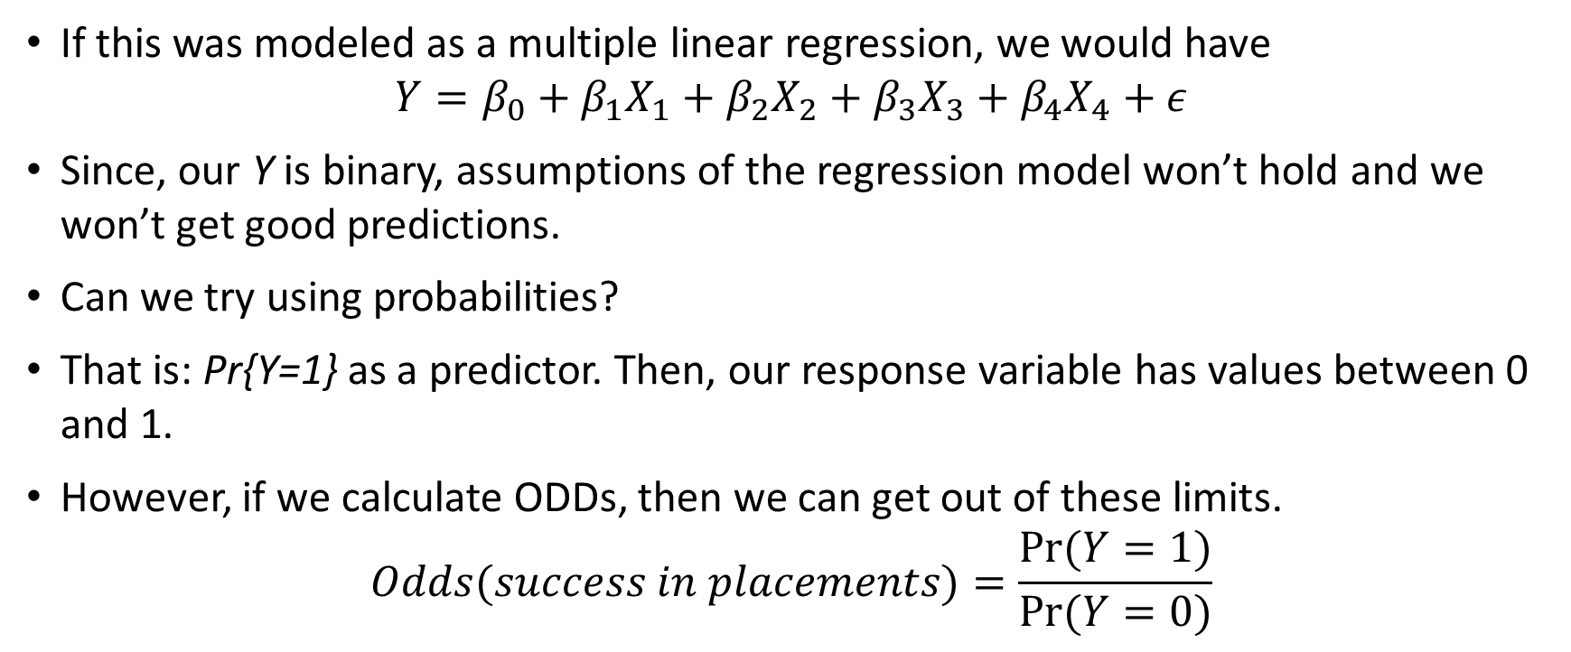
Solution method: Regression
If this was modeled as a multiple linear regression, we would have
$$Y=β_{0}+β_{1}X_{1}+β_{2}X_{2}+β_{3}X_{3}+β_{4}X_{4}+ε$$
Since, our Y is binary, assumptions of the regression model won’t hold and we won’t get good predictions.
Can we try using probabilities?
That is: Pr{Y=1} as a predictor. Then, our response variable has values between 0 and 1.
However, if we calculate ODDs, then we can get out of these limits.
$$Odds(success in placements)=\frac{Pr⁡(Y=1)}{Pr⁡(Y=0)}$$

Slide 8
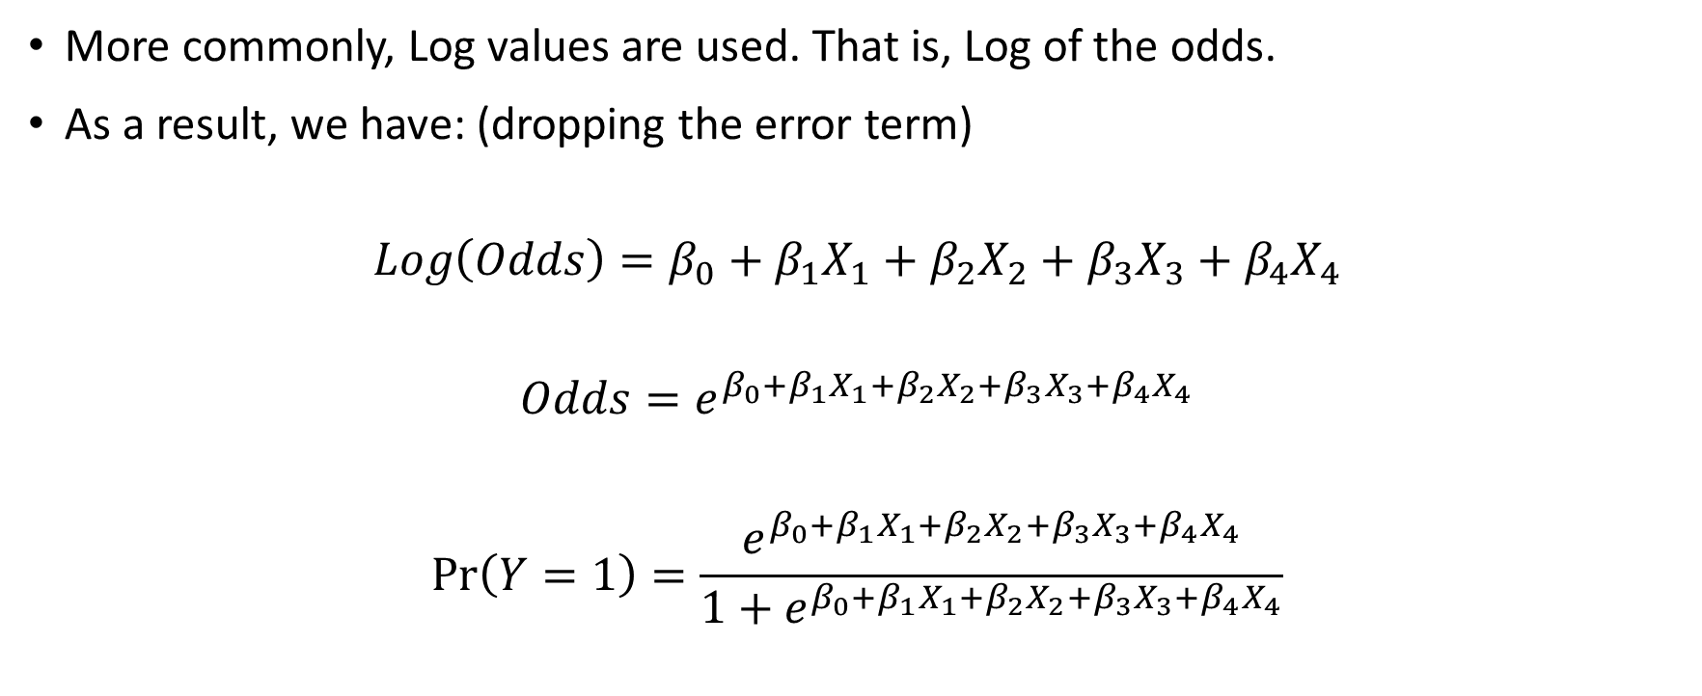
Solution method: Regression
More commonly, Log values are used. That is, Log of the odds.
As a result, we have: (dropping the error term)
$$Log\left(Odds\right)=β_{0}+β_{1}X_{1}+β_{2}X_{2}+β_{3}X_{3}+β_{4}X_{4}$$
$$Odds=e^{β_{0}+β_{1}X_{1}+β_{2}X_{2}+β_{3}X_{3}+β_{4}X_{4}}$$
$$\operatorname{Pr}\left(Y=1\right)=\frac{e^{β_{0}+β_{1}X_{1}+β_{2}X_{2}+β_{3}X_{3}+β_{4}X_{4}}}{1+e^{β_{0}+β_{1}X_{1}+β_{2}X_{2}+β_{3}X_{3}+β_{4}X_{4}}}$$

Slide 9
Solution method: Regression
Now we can run the regression model and estimate the regression coefficients (the β’s).
The objective function used for this estimation: maximization of the log-likelihood. That is the log of probability of the correct prediction.
See the Excel sheet.

Slide 10
Regression: Calculations explained
Notice that this regression will give us the “forecasted” probability that the student will be placed (Pr{Y=1}).
However, we want the value for our response variable (Y). And not the probability that Y will take on certain value.
Towards that, we define a threshold probability – if the forecasted probability value is above the threshold, we say that Y = 1.
On the other hand, if the forecasted probability is below the threshold, we can say that Y = 0 (the student won’t be placed).

Slide 11
Evaluation of the Model
How do we judge whether this logistic regression model is a good?
Typical statistical indicators: (generally based on the Log-likelihood) – deviance, R², and information criteria (Akaike, and Baye’s).
Some of them have a threshold (often χ² based statistic) or sometime it is higher-the-better type (e.g. R²).
Other performance indicators: (generally based on correct identification) – Accuracy, Precision, Recall.
Obviously, they are all large-the-better type performance indicators.

Slide 12
Evaluation of the Model
Accuracy: Measure of the total number of predictions a model gets right, including both True Positives and True Negatives.
Recall: Indicates the percentage of the response values (that we are interested in) were actually captured by the model.
Precision: Measures the percentage of the predicted response values (that we are interested in) that were correct.

Slide 13
Evaluation of the Model
For the student placement example, the response variable was binary (and we were interested in the chances of student getting placed, Y = 1).
The performance measures can be interpreted as:
Accuracy: The ratio of the number of times predicted and actual Y values matched (for both Y = 0 and Y = 1) to the total observations in the sample.
Recall: The ratio of the number of times the prediction for Y was 1, to the total number of instances in the sample where Y was actually 1.
Precision: The ratio of the number of times the actual Y was 1, to the total number of instances where the prediction for Y was 1.

Slide 14
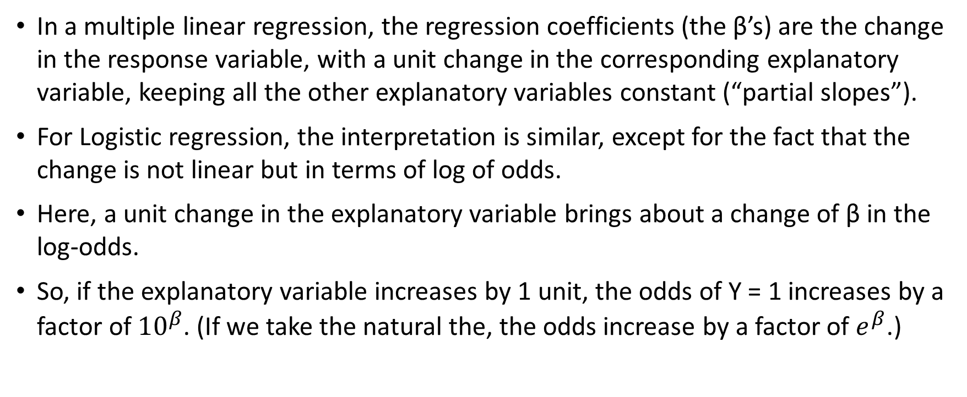
Interpretation of the coefficients
In a multiple linear regression, the regression coefficients (the β’s) are the change in the response variable, with a unit change in the corresponding explanatory variable, keeping all the other explanatory variables constant (“partial slopes”).
For Logistic regression, the interpretation is similar, except for the fact that the change is not linear but in terms of log of odds.
Here, a unit change in the explanatory variable brings about a change of β in the log-odds.
So, if the explanatory variable increases by 1 unit, the odds of Y = 1 increases by a factor of ${10}^{β}$. (If we take the natural the, the odds increase by a factor of $e^{β}$.)

Slide 15
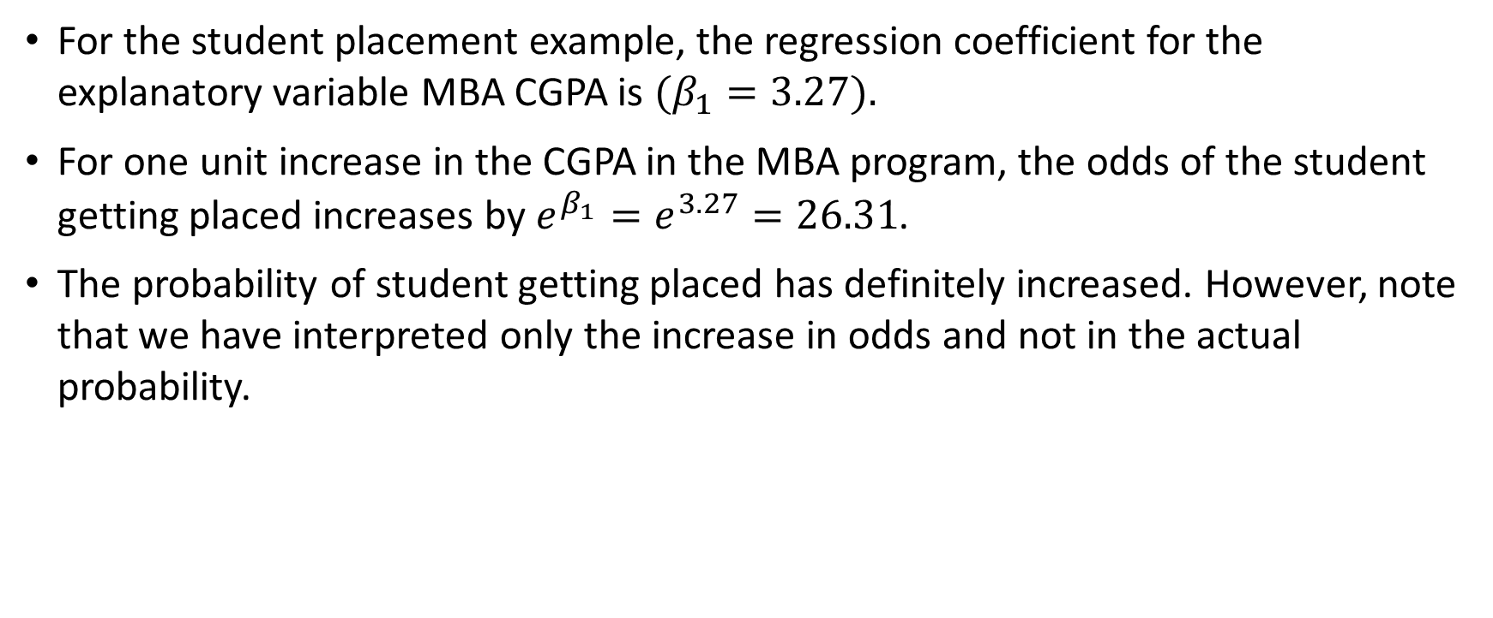
Interpretation of the coefficients
For the student placement example, the regression coefficient for the explanatory variable MBA CGPA is $(β_{1}=3.27).$
For one unit increase in the CGPA in the MBA program, the odds of the student getting placed increases by $e^{β_{1}}=e^{3.27}=26.31$.
The probability of student getting placed has definitely increased. However, note that we have interpreted only the increase in odds and not in the actual probability.

